Slide 1
Selecting Data model and Tools
Akshay Bahadur
SDE at Symantec
Explore ML Academy, Hyderabad (September 14, 2019)

Slide 2
Agenda
What is a machine learning model?
Types of Learning Models
Classification Models
Regression Models
Tools and Frameworks
akshaybahadur.com

Slide 3

Motivation
akshaybahadur.com

Slide 4
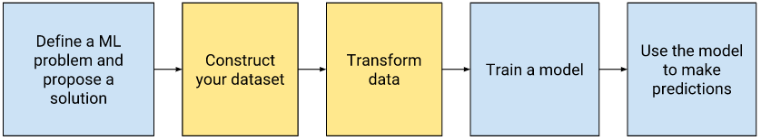
The typical machine learning workflow
Source
akshaybahadur.com

Slide 5
The typical machine learning workflow
Now, We are here!
Source
akshaybahadur.com

Slide 6
What is a machine learning model?

Slide 7
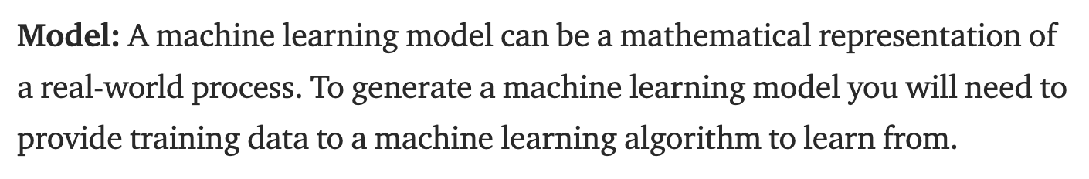
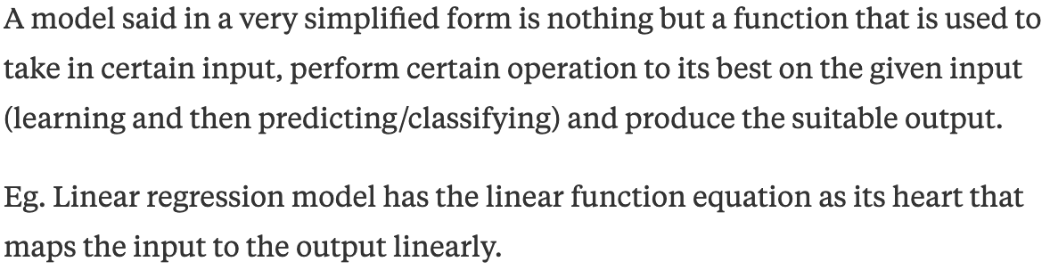
akshaybahadur.com

Slide 8
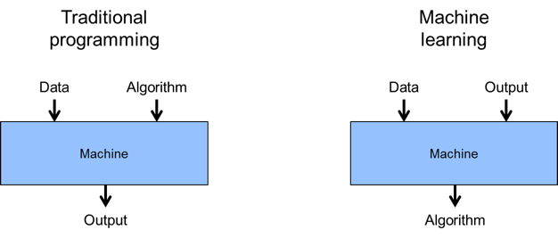
Difference b/w Traditional programming and Machine Learning
akshaybahadur.com

Slide 9
Types of Learning Models

Slide 10
Classification Models
Supervised problem
The aim of the model is to classify a given data point into one out of n classes
Example – Logistic Regression, Neural Networks, etc.
akshaybahadur.com

Slide 11
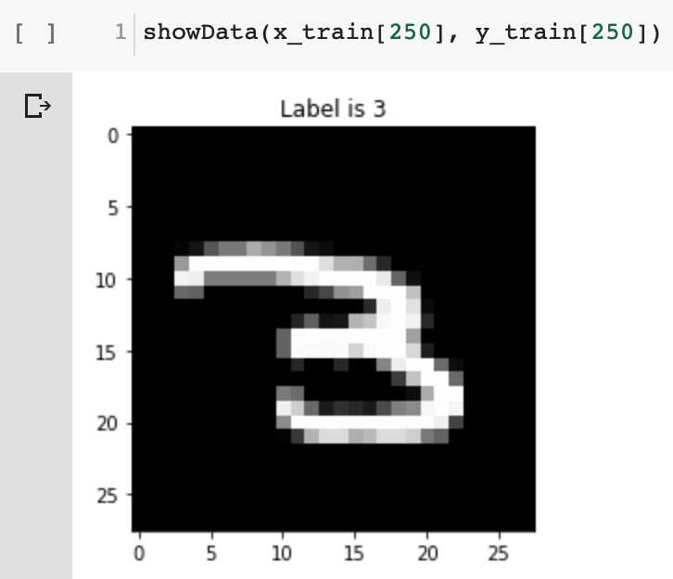
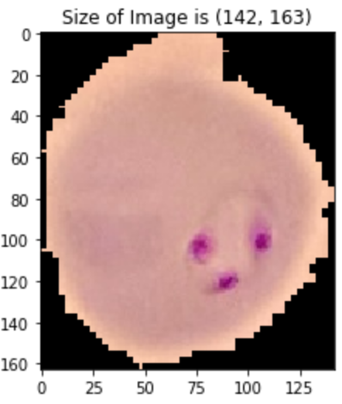
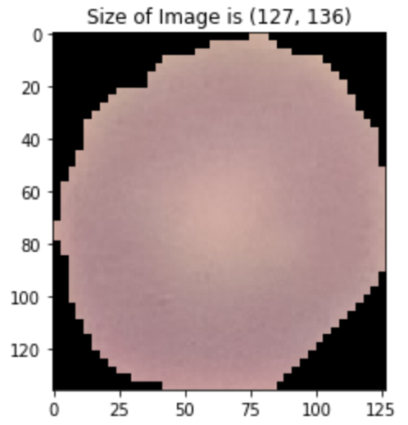
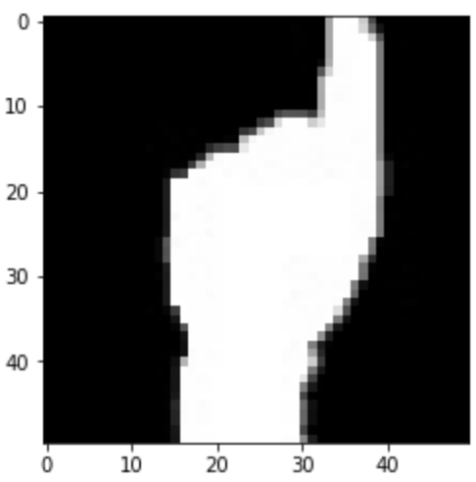
Classification Models
Uninfected
parasitized
Label is 1
akshaybahadur.com

Slide 12
Regression Models
Supervised problem
The aim of the model is to finds out a linear relationship between x (input) and y(output)
Example – Linear Regression, Neural Networks, etc.
akshaybahadur.com

Slide 13
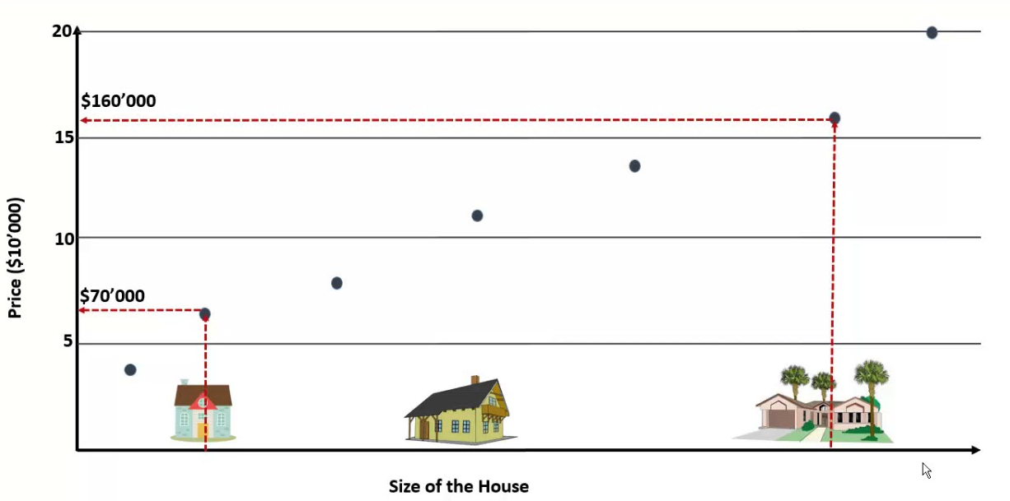
Regression Models
akshaybahadur.com

Slide 14

Classification v/s Regression
akshaybahadur.com

Slide 15

How does a model learn
akshaybahadur.com

Slide 16

How does a model learn
akshaybahadur.com

Slide 17
Tools and Frameworks

Slide 18
Tools
NumPy
Scikit Learn
Tf.Keras
Tensorflow
akshaybahadur.com

Slide 19
Numpy
Numpy is a library for the Python programming language, adding support for large, multi-dimensional arrays and matrices
Numpy forms the foundation of the Machine Learning stack
akshaybahadur.com

Slide 20
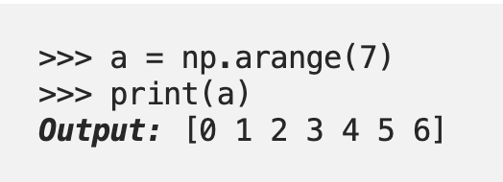
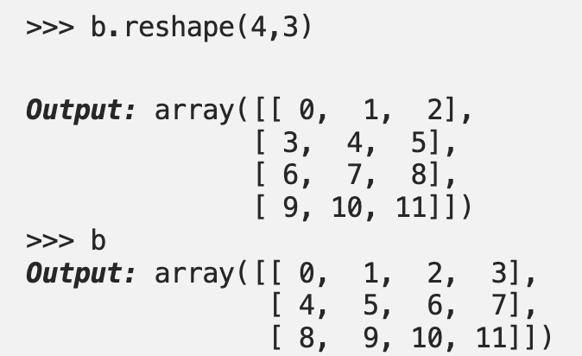
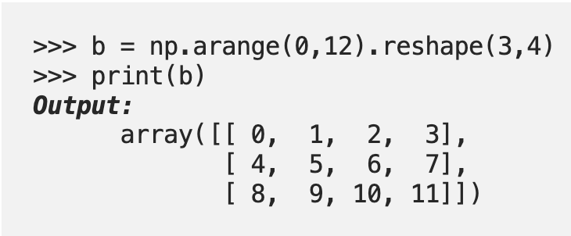
Numpy
One-dimensional array
Reshaping an array
Two-dimensional array
akshaybahadur.com

Slide 21
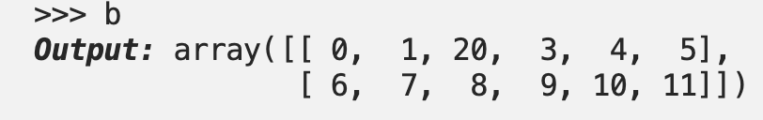
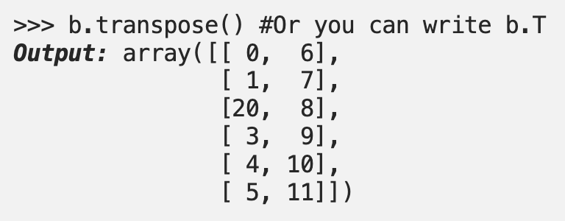
Numpy
Flattening the matrix
Matrix B
Transpose of matrix
akshaybahadur.com

Slide 22
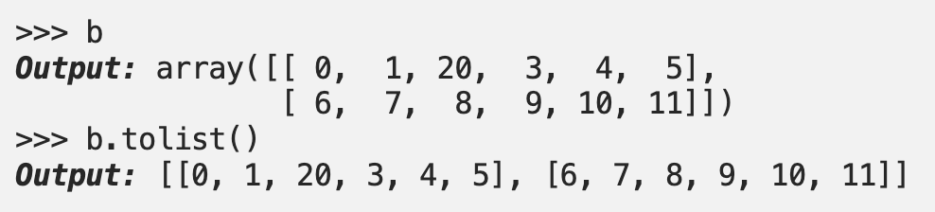
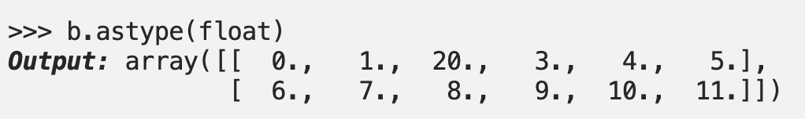
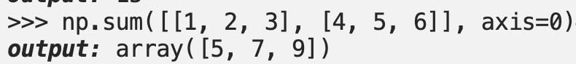
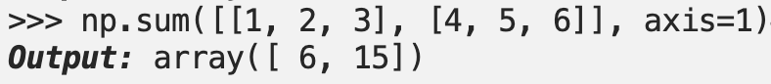
Numpy
Array to List
Convert type
Sum along the columns
Sum along the columns
akshaybahadur.com

Slide 23
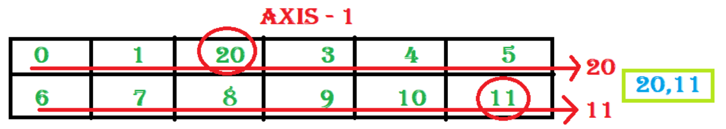
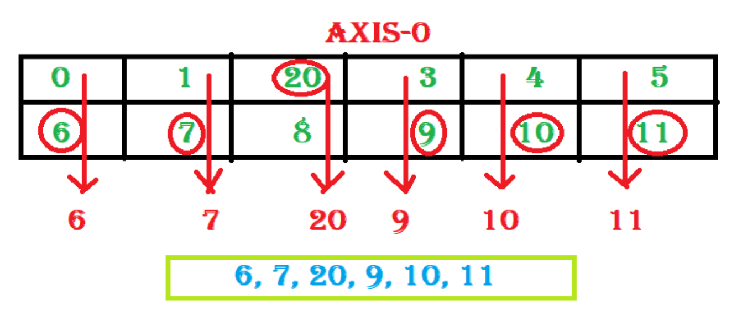
Numpy
np.max()
akshaybahadur.com

Slide 24
Tf.Keras
Keras is a high-level API to build and train deep learning models. It's used for fast prototyping, advanced research, and production, with three key advantages:
User friendly
Modular and composable
Easy to extend
akshaybahadur.com

Slide 25

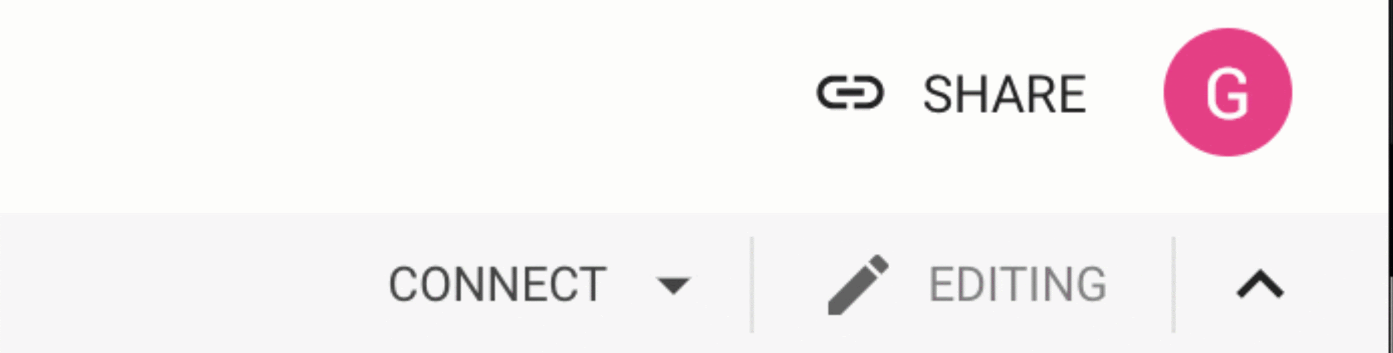

MNIST
https://www.tensorflow.org/tutorials/keras/basic_classification
Open the exercise in Colab
Sign in with your Google account
Activate the Runtime
Run code
akshaybahadur.com

Slide 26
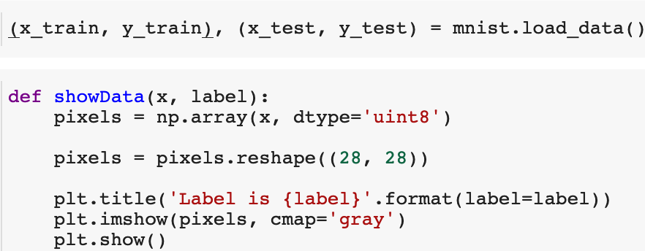
MNIST
akshaybahadur.com

Slide 27
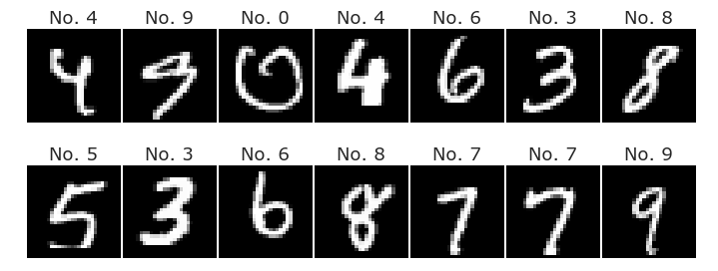
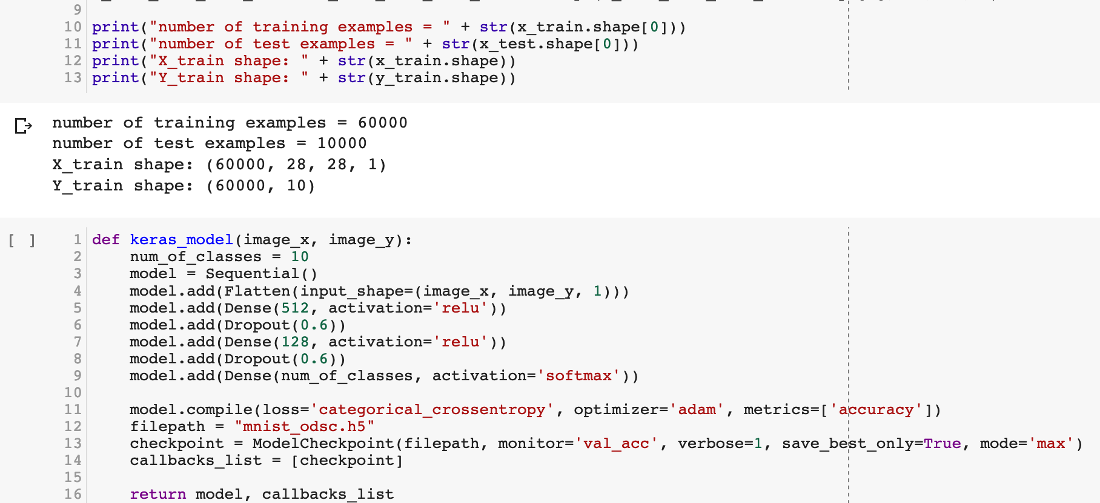
MNIST
akshaybahadur.com

Slide 28
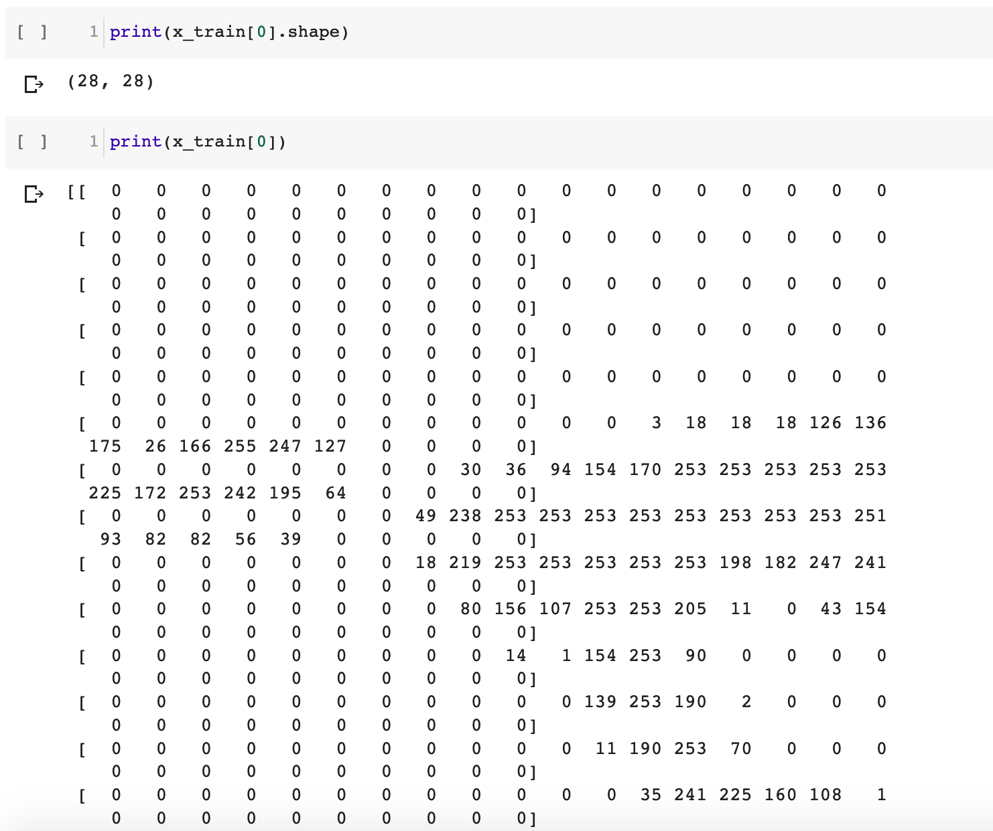
akshaybahadur.com

Slide 29
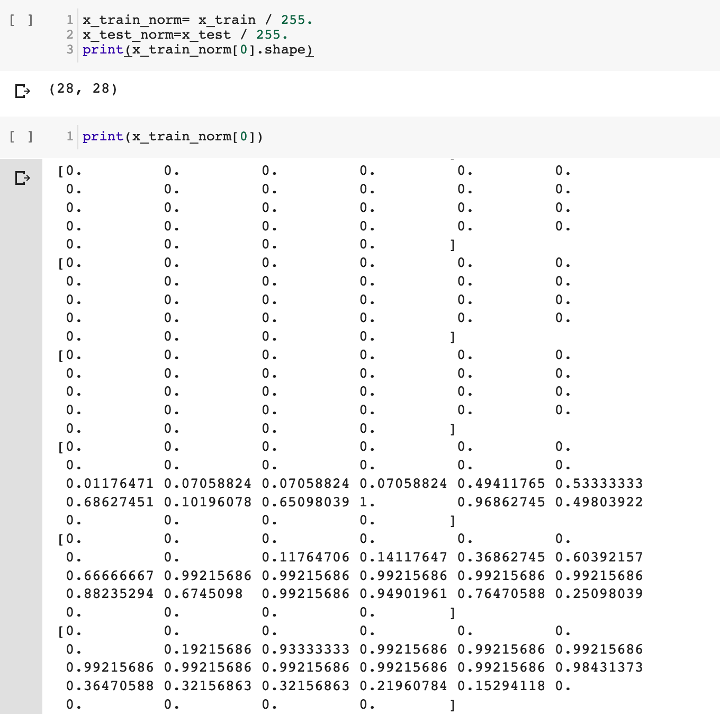
akshaybahadur.com

Slide 30
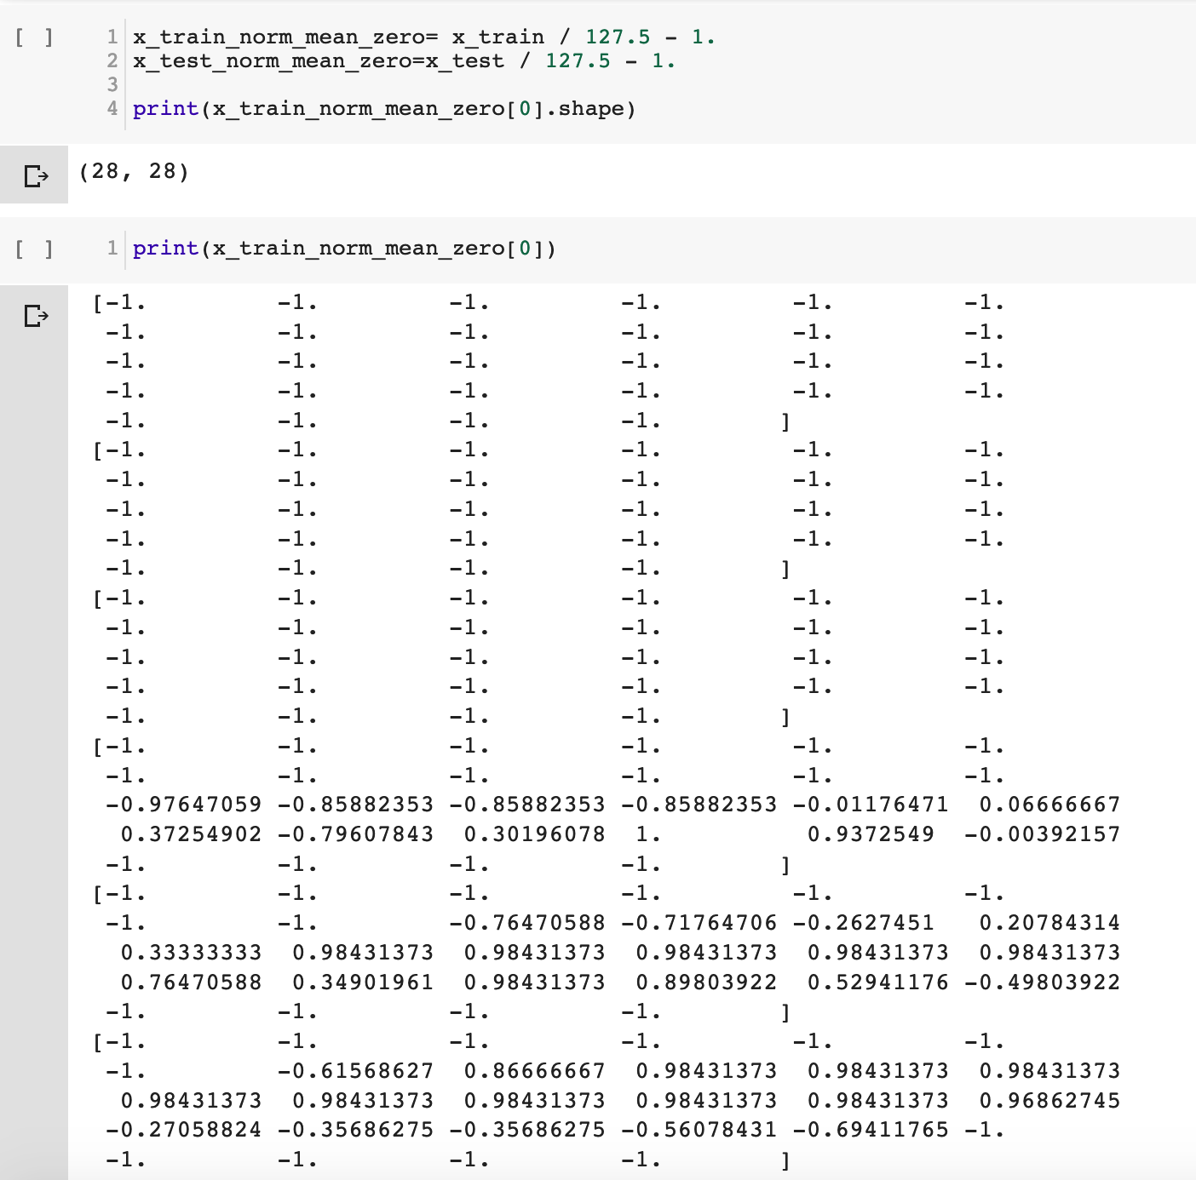
akshaybahadur.com

Slide 31
MNIST
Setup the Layers
model = keras.Sequential([
keras.layers.Flatten(input_shape=(28, 28)),
keras.layers.Dense(512, activation=tf.nn.relu),
keras.layers.Dropout(0.6)
keras.layers.Dense(128, activation=tf.nn.relu),
keras.layers.Dropout(0.6)
keras.layers.Dense(10, activation=tf.nn.softmax)
])
akshaybahadur.com

Slide 32
MNIST
Compile the model
model.compile(optimizer='adam',
loss='categorical_crossentropy',
metrics=['accuracy'])
akshaybahadur.com

Slide 33
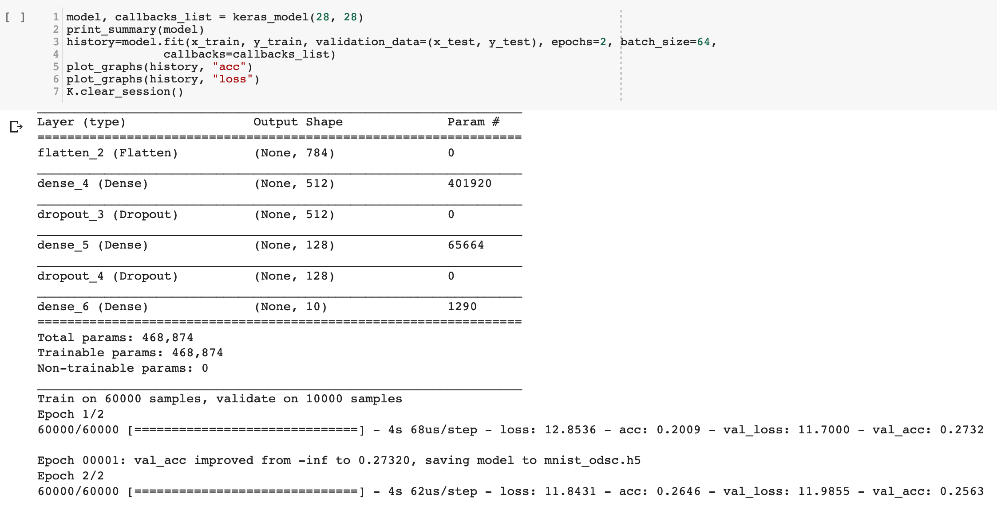
MNIST
Train the Model
history = model.fit(train_images, train_labels, epochs=2)
akshaybahadur.com

Slide 34
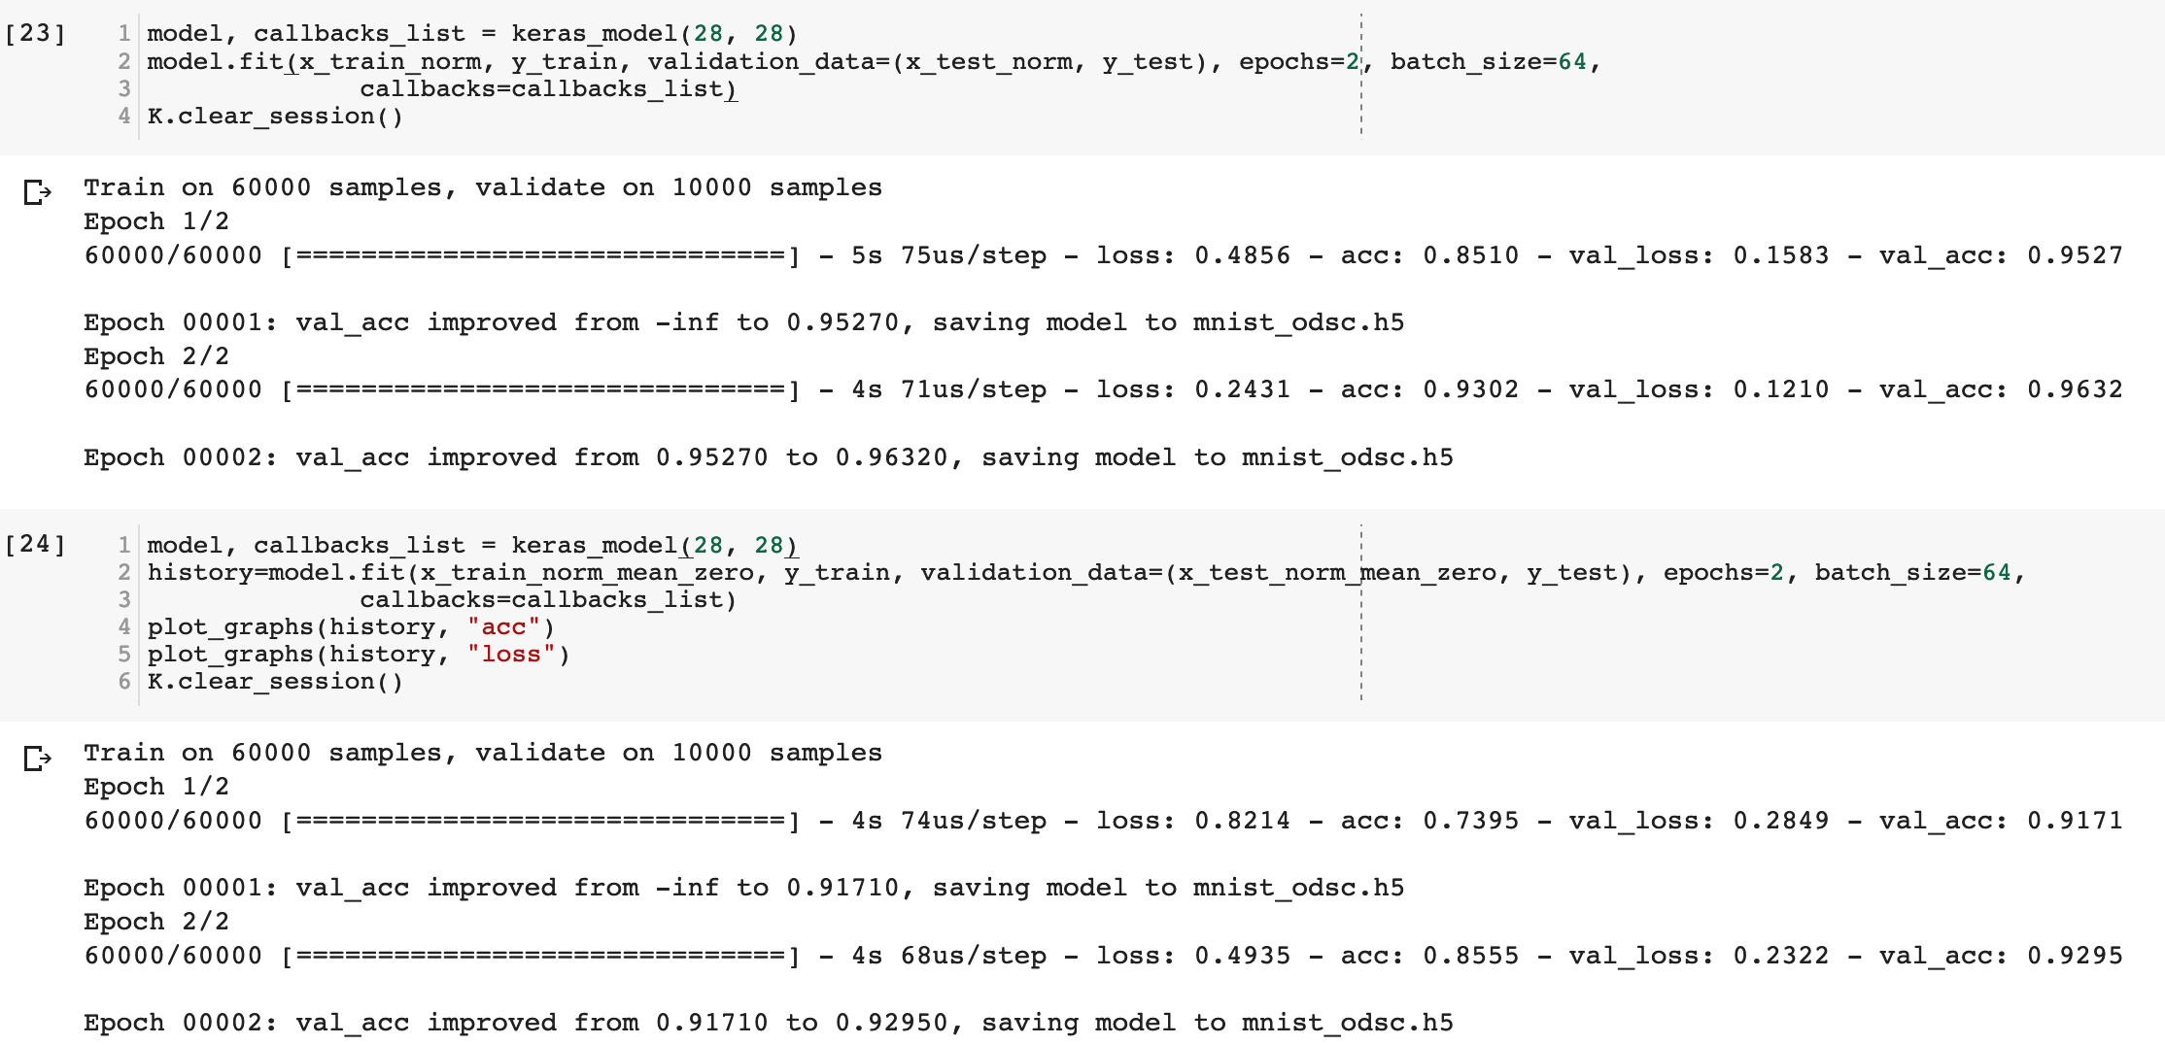
akshaybahadur.com

Slide 35
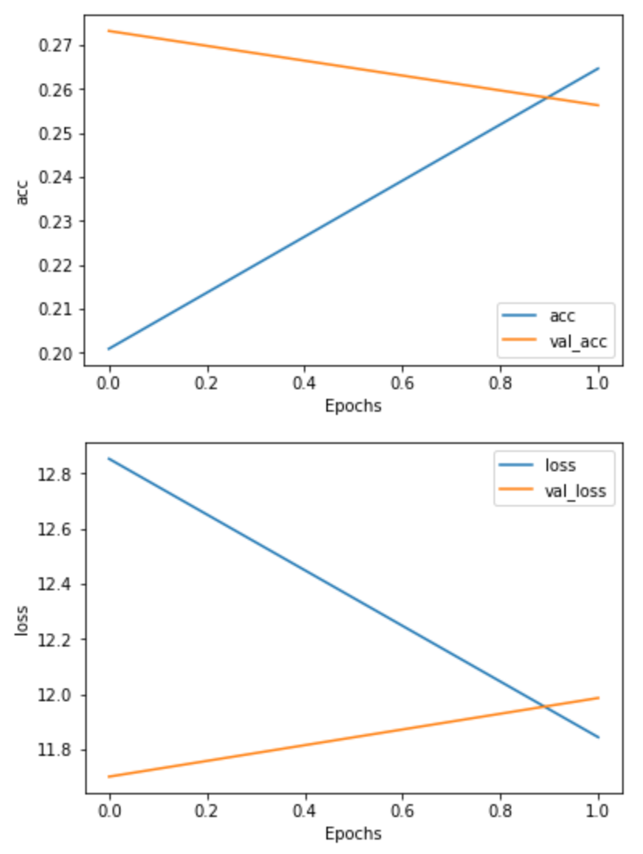
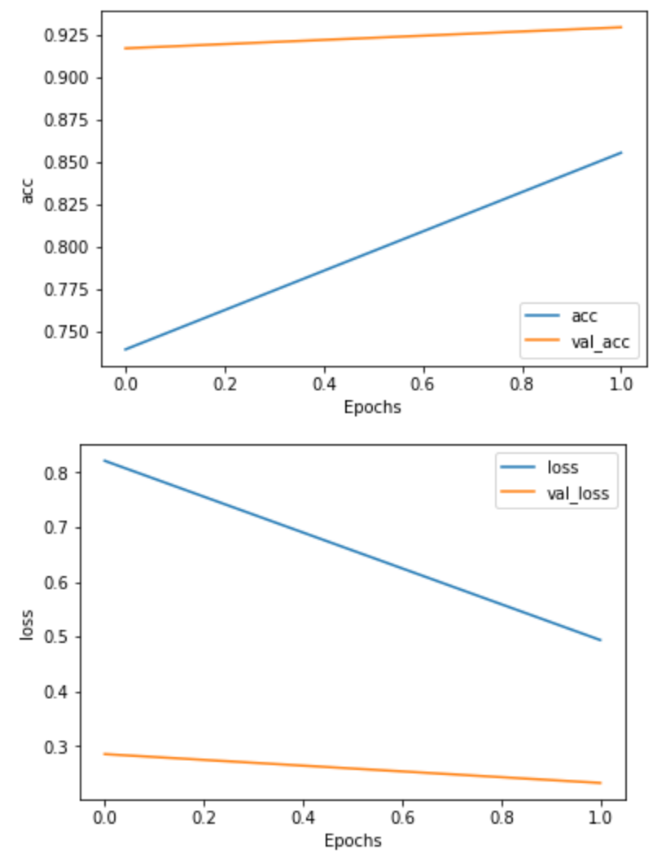
akshaybahadur.com

Slide 36
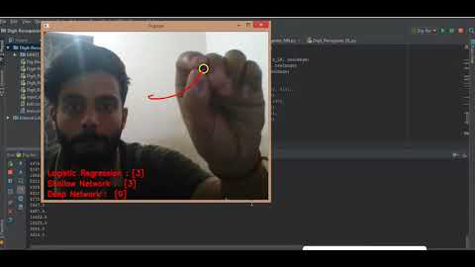
MNIST
Integrating ML with other technologies
akshaybahadur.com

Slide 37

MNIST
Integrating ML with other technologies
akshaybahadur.com

Slide 38
Wrapping up
The process of training
Identify the problem
Select the model
Fine tune the model
Inferences
ML is not always the answer.
akshaybahadur.com

Slide 39



See you next time
Find me here:
akshaybahadur.com
Thank you very much :)
akshaybahadur.com

